Slide 1
Law of Large Number

Slide 2
Law of large numbers
In probability theory, the law of large numbers (LLN) is a theorem that describes the result of performing the same experiment a large number of times. According to the law, the average of the results obtained from a large number of trials should be close to the expected value and will tend to become closer to the expected value as more trials are performed.
The LLN is important because it guarantees stable long-term results for the averages of some random events.

Slide 3


It is also important to note that the LLN only applies to the average. Therefore, while
other formulas that look similar are not verified, such as the raw deviation from "theoretical results"
not only does it not converge toward zero as n increases, but it tends to increase in absolute value as n increases.

Slide 4

For example, a single roll of a fair, six-sided dice produces one of the numbers 1, 2, 3, 4, 5, or 6, each with equal probability. Therefore, the expected value of the average of the rolls is:
According to the law of large numbers, if a large number of six-sided dice are rolled, the average of their values (sometimes called the sample mean) is likely to be close to 3.5, with the precision increasing as more dice are rolled.

Slide 5

It follows from the law of large numbers that the empirical probability of success in a series of Bernoulli trials will converge to the theoretical probability. For a Bernoulli random variable, the expected value is the theoretical probability of success, and the average of n such variables (assuming they are independent and identically distributed (i.i.d.)) is precisely the relative frequency.
For example, a fair coin toss is a Bernoulli trial. When a fair coin is flipped once, the theoretical probability that the outcome will be heads is equal to ¹⁄₂. Therefore, according to the law of large numbers, the proportion of heads in a "large" number of coin flips "should be" roughly ¹⁄₂. In particular, the proportion of heads after n flips will almost surely converge to ¹⁄₂ as n approaches infinity.

Slide 6
Forms
There are two different versions of the law of large numbers that are described below.
They are called the strong law of large numbers and the weak law of large numbers.

Slide 7


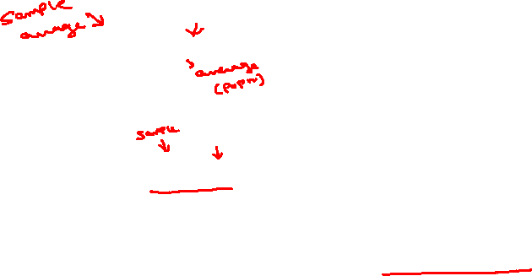

Weak law
The weak law of large numbers (also called Khinchin's law) states that the sample average converges in probability towards the expected value.
That is, for any positive number ε,
Interpreting this result, the weak law states that for any nonzero margin specified (ε), no matter how small, with a sufficiently large sample there will be a very high probability that the average of the observations will be close to the expected value; that is, within the margin.

Slide 8



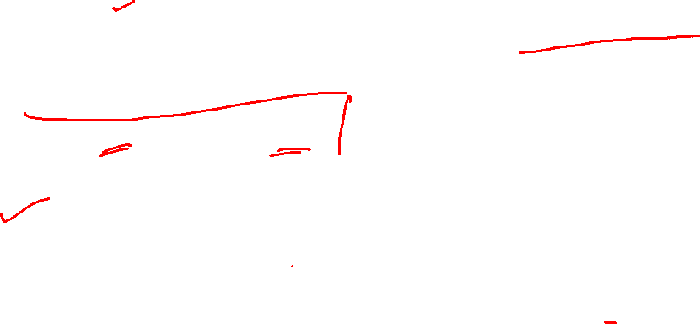
Strong law
The strong law of large numbers (also called Kolmogorov's law) states that the sample average converges almost surely to the expected value.
That is,
What this means is that the probability that, as the number of trials n goes to infinity, the average of the observations converges to the expected value, is equal to one.

Slide 9
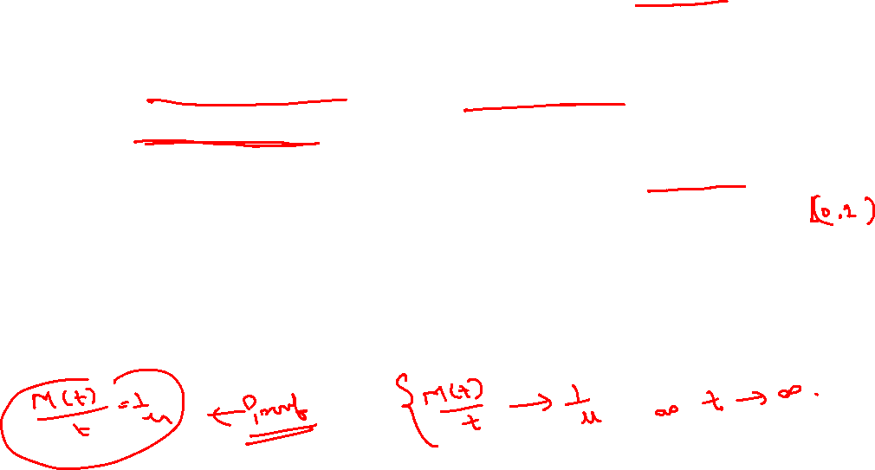
Blackwell renewal theorem
Consider a piece of equipment that has a finite but random life-time. Suppose one starts with a new one and, after that fails, replaces it with a second new one and, after that one fails, replaces it with a third new one and so on indefinitely. Such a process is called a renewal process (also Renewal theory) and objects of interest are the behavior for large (time) t:
i) of the average number of units replaced in the interval (t,t+h], where h is fixed;
ii) of the probability of renewal at time t;
iii) of the age, the remaining life and the total life of the (current) unit in operation at time t. The mathematical theory of such processes is called renewal theory and Blackwell's renewal theorem plays a central role in it.

